Slide 1
Advanced Keylogger [aka. hackMyKeys]
B. PAVAN KUMAR [238W5A1201] - K. LILLY [238W5A1207 ]

Slide 2
Today’s AGENDA!
Introduction.
Problems with Classical Keyloggers
Proposed Keylogger & It’s Features
Implementation & Working
Practical Demo
Conclusion

Slide 3
Introduction
1
Let’s Start…

Slide 4
Tool designed to secretly record keystrokes.
Used for monitoring or malicious purposes.
Capture all keyboard inputs, including passwords and sensitive information.
Software-based: Installed as programs on computers.
Hardware-based: Physical devices connected to keyboards.
Operate silently in the background without user awareness.
Sends all the information to the attacker with the help of emails or cloud based solutions

Slide 5
Problems with Classical Keyloggers
2

Slide 6
Problems…
Limited Data Capture
Traditional keyloggers focus solely on capturing keystrokes and may not collect additional contextual information such as system details or screenshots.
Single Data Transmission Method:
Many keyloggers rely on sending captured data via email, which can be easily traced by vigilant users or security software.
Detection by Anti-virus Software:
Due to their well-known behavior, classical keyloggers are often detected and blocked by anti-virus programs, limiting their effectiveness.

Slide 7
Problems…
Inability to Bypass Encrypted Data:
Keyloggers may struggle to capture keystrokes entered into encrypted fields, such as those used for password entry in secure websites or applications.
Limited Remote Control:
Classical keyloggers may lack remote control capabilities, such as the ability to update or modify their functionality after installation, limiting their adaptability to changing circumstances.

Slide 8
Proposed Keylogger & It’s Features
3

Slide 9
PROPOSED KEYLOGGER
A Python script designed for comprehensive keystroke logging and system information capture. hackMyKeys logs keyboard inputs, including keystrokes, key combinations, and system events, while also capturing critical system details such as processor information, operating system version, and private IP address.
This tool seamlessly integrates with Dropbox cloud storage via the Dropbox API, enabling remote monitoring and secure data transmission. hackMyKeys serves as an educational resource for cybersecurity enthusiasts, students, and professionals interested in exploring keylogging techniques and understanding system vulnerabilities. It emphasizes proactive cybersecurity practices and the importance of safeguarding sensitive information against unauthorized access and data breaches.

Slide 10
FEATURES
Secure Data Transmission:
Uploads captured data directly to the attacker's cloud storage, bypassing the traceable method of email transmission.
Comprehensive Data Capture:
Captures not only keystrokes but also detailed system information, providing a more comprehensive view of the victim's activities.
On-device Data Encryption:
Encrypts captured data directly on the user's machine, ensuring data security and making it difficult for unauthorized parties to access sensitive information.

Slide 11
FEATURES
Stealth Operation:
Operates covertly to minimize detection, enhancing its effectiveness for monitoring or malicious purposes.
Adaptability:
Designed to adapt to changing security measures and user behaviors, ensuring continued effectiveness over time.

Slide 12
Implementation
4

Slide 13
Language & Library Specs.
Language Used: Python
Libraries…
pynput: Used for monitoring keyboard events.
platform: Used for gathering system information.
socket: Used for obtaining hostname and IP address.
getpass: Used for retrieving the username of the current user.
dropbox: Used for interacting with Dropbox's API.

Slide 14
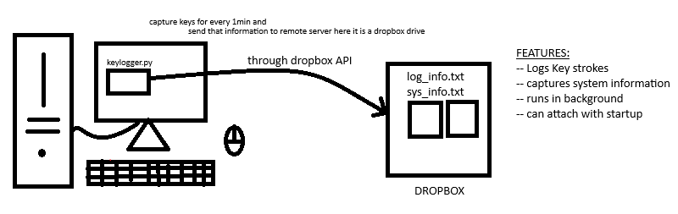
How Does it Works?

Slide 15
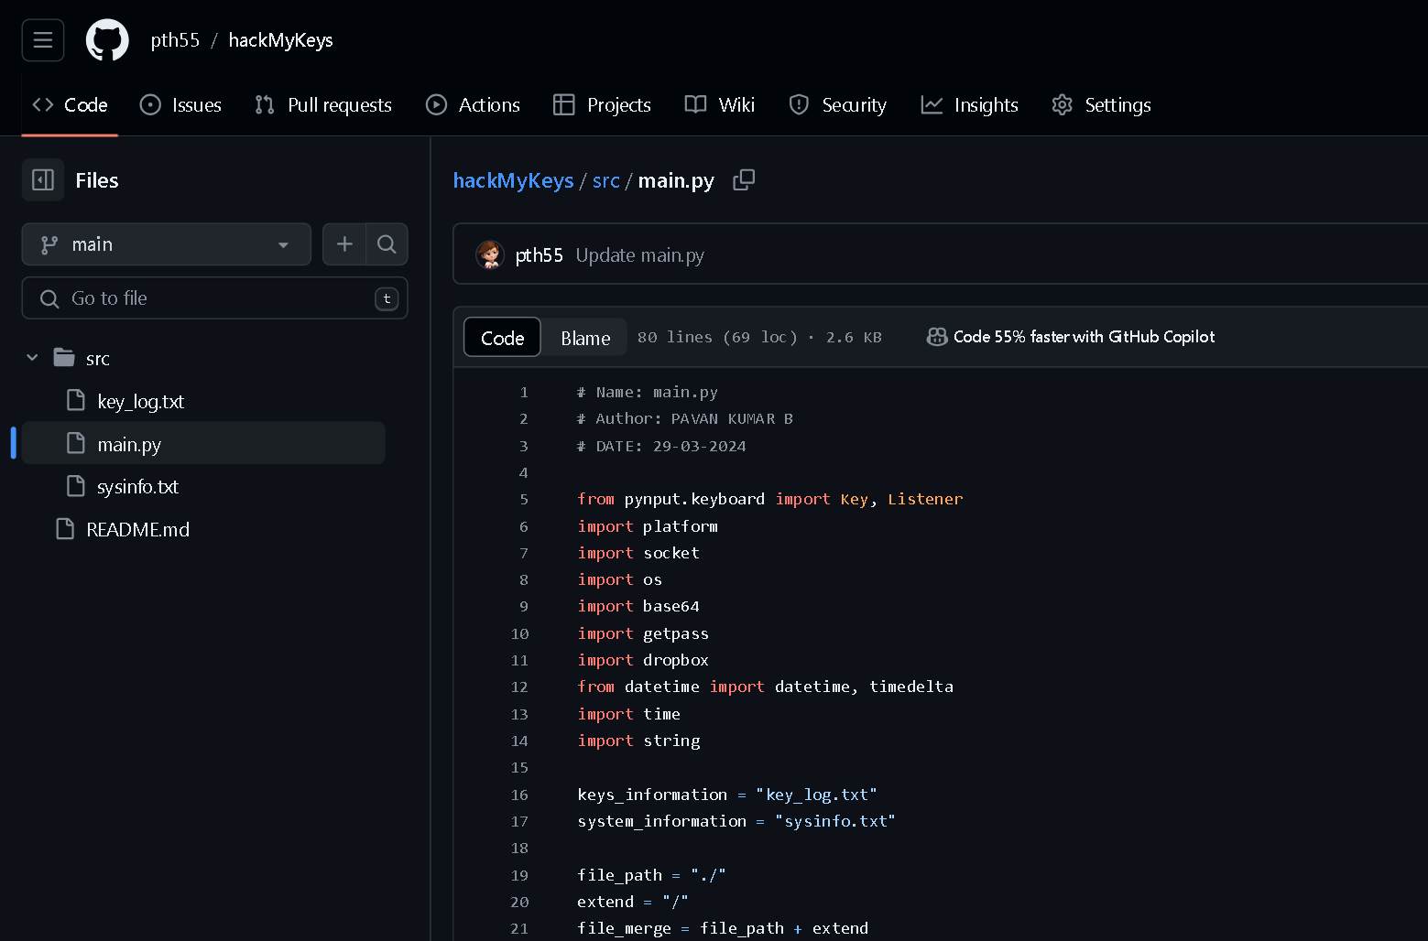
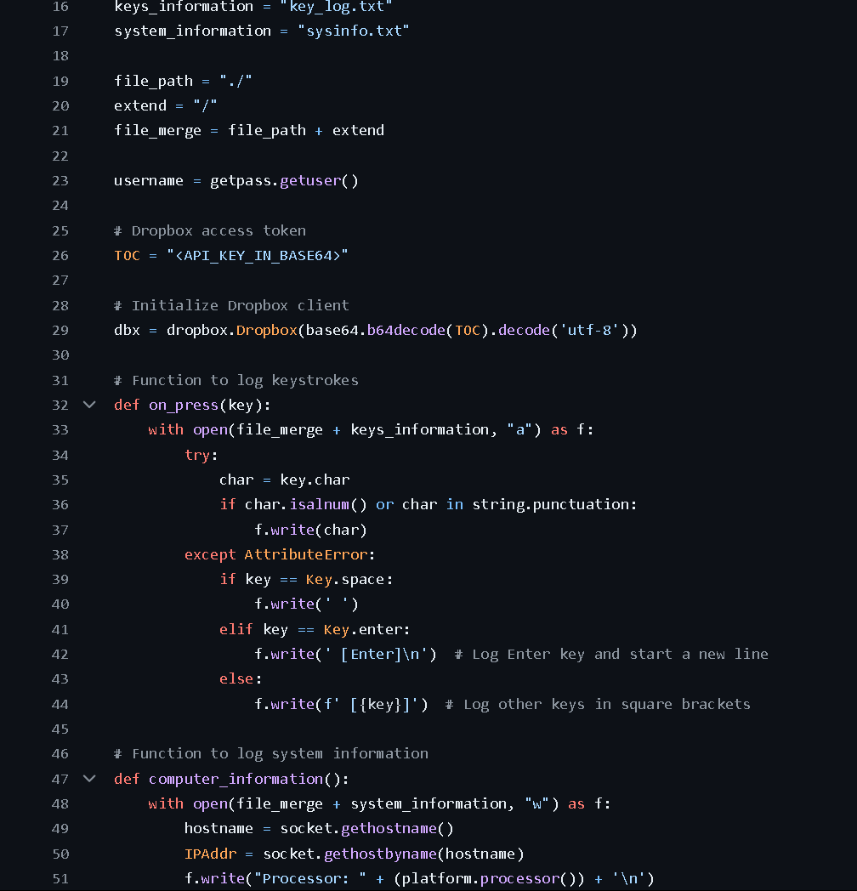
Screenshots of Code & Git Repo

Slide 16
Practical Demo
5

Slide 17
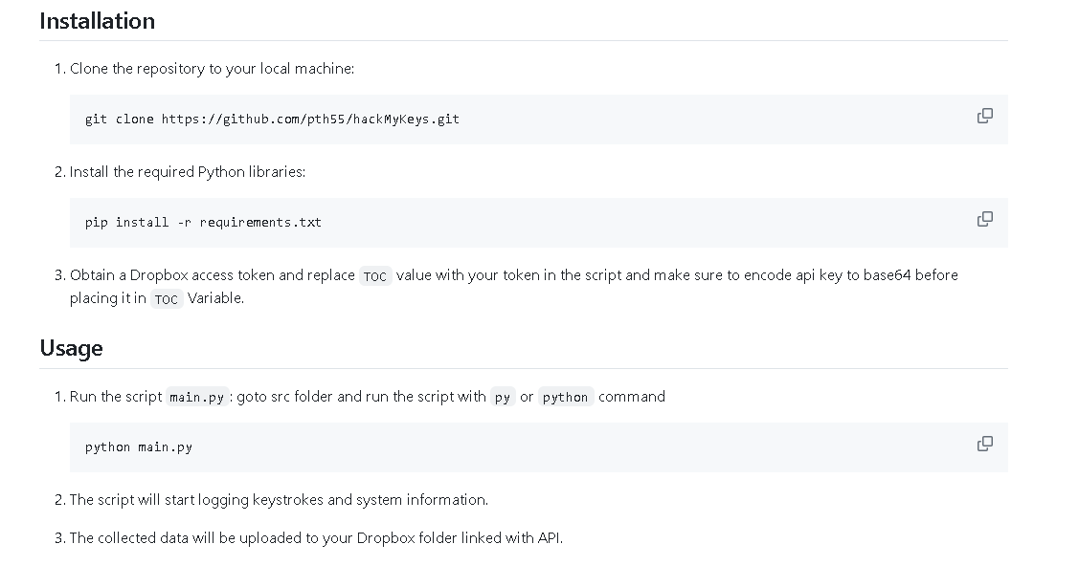
GitHub link: https://github.com/pth55/hackMyKeys/

Slide 18
Conclusion
6

Slide 19
hackMyKeys offers a robust solution for keystroke logging and system information capture, facilitating remote monitoring and data collection. While it serves as a valuable educational resource for cybersecurity enthusiasts, ethical considerations must be paramount. Users should deploy this tool responsibly, ensuring consent and adhering to legal and privacy regulations. By prioritizing ethical use, hackMyKeys underscores the importance of maintaining integrity and respect for privacy in cybersecurity practices.

Slide 20
CONTRIBUTIONS…
🌟 Want to contribute to my project on GitHub?
All are welcome! Feel free to jump in and make a difference. Let's build something amazing together! 💻
#OpenSource #GitHub

Slide 21
CONTRIBUTIONS…
Just Fork It! https://github.com/pth55/hackMyKeys/ ✌️

Slide 22
THANKS!
Any questions?
You can find me at
https://github.com/pth55

